Slide 1
APA! Medical Clinic Apprenticeships
Jordana Moerbe, Medical Clinic Manager
Alternative

Slide 2
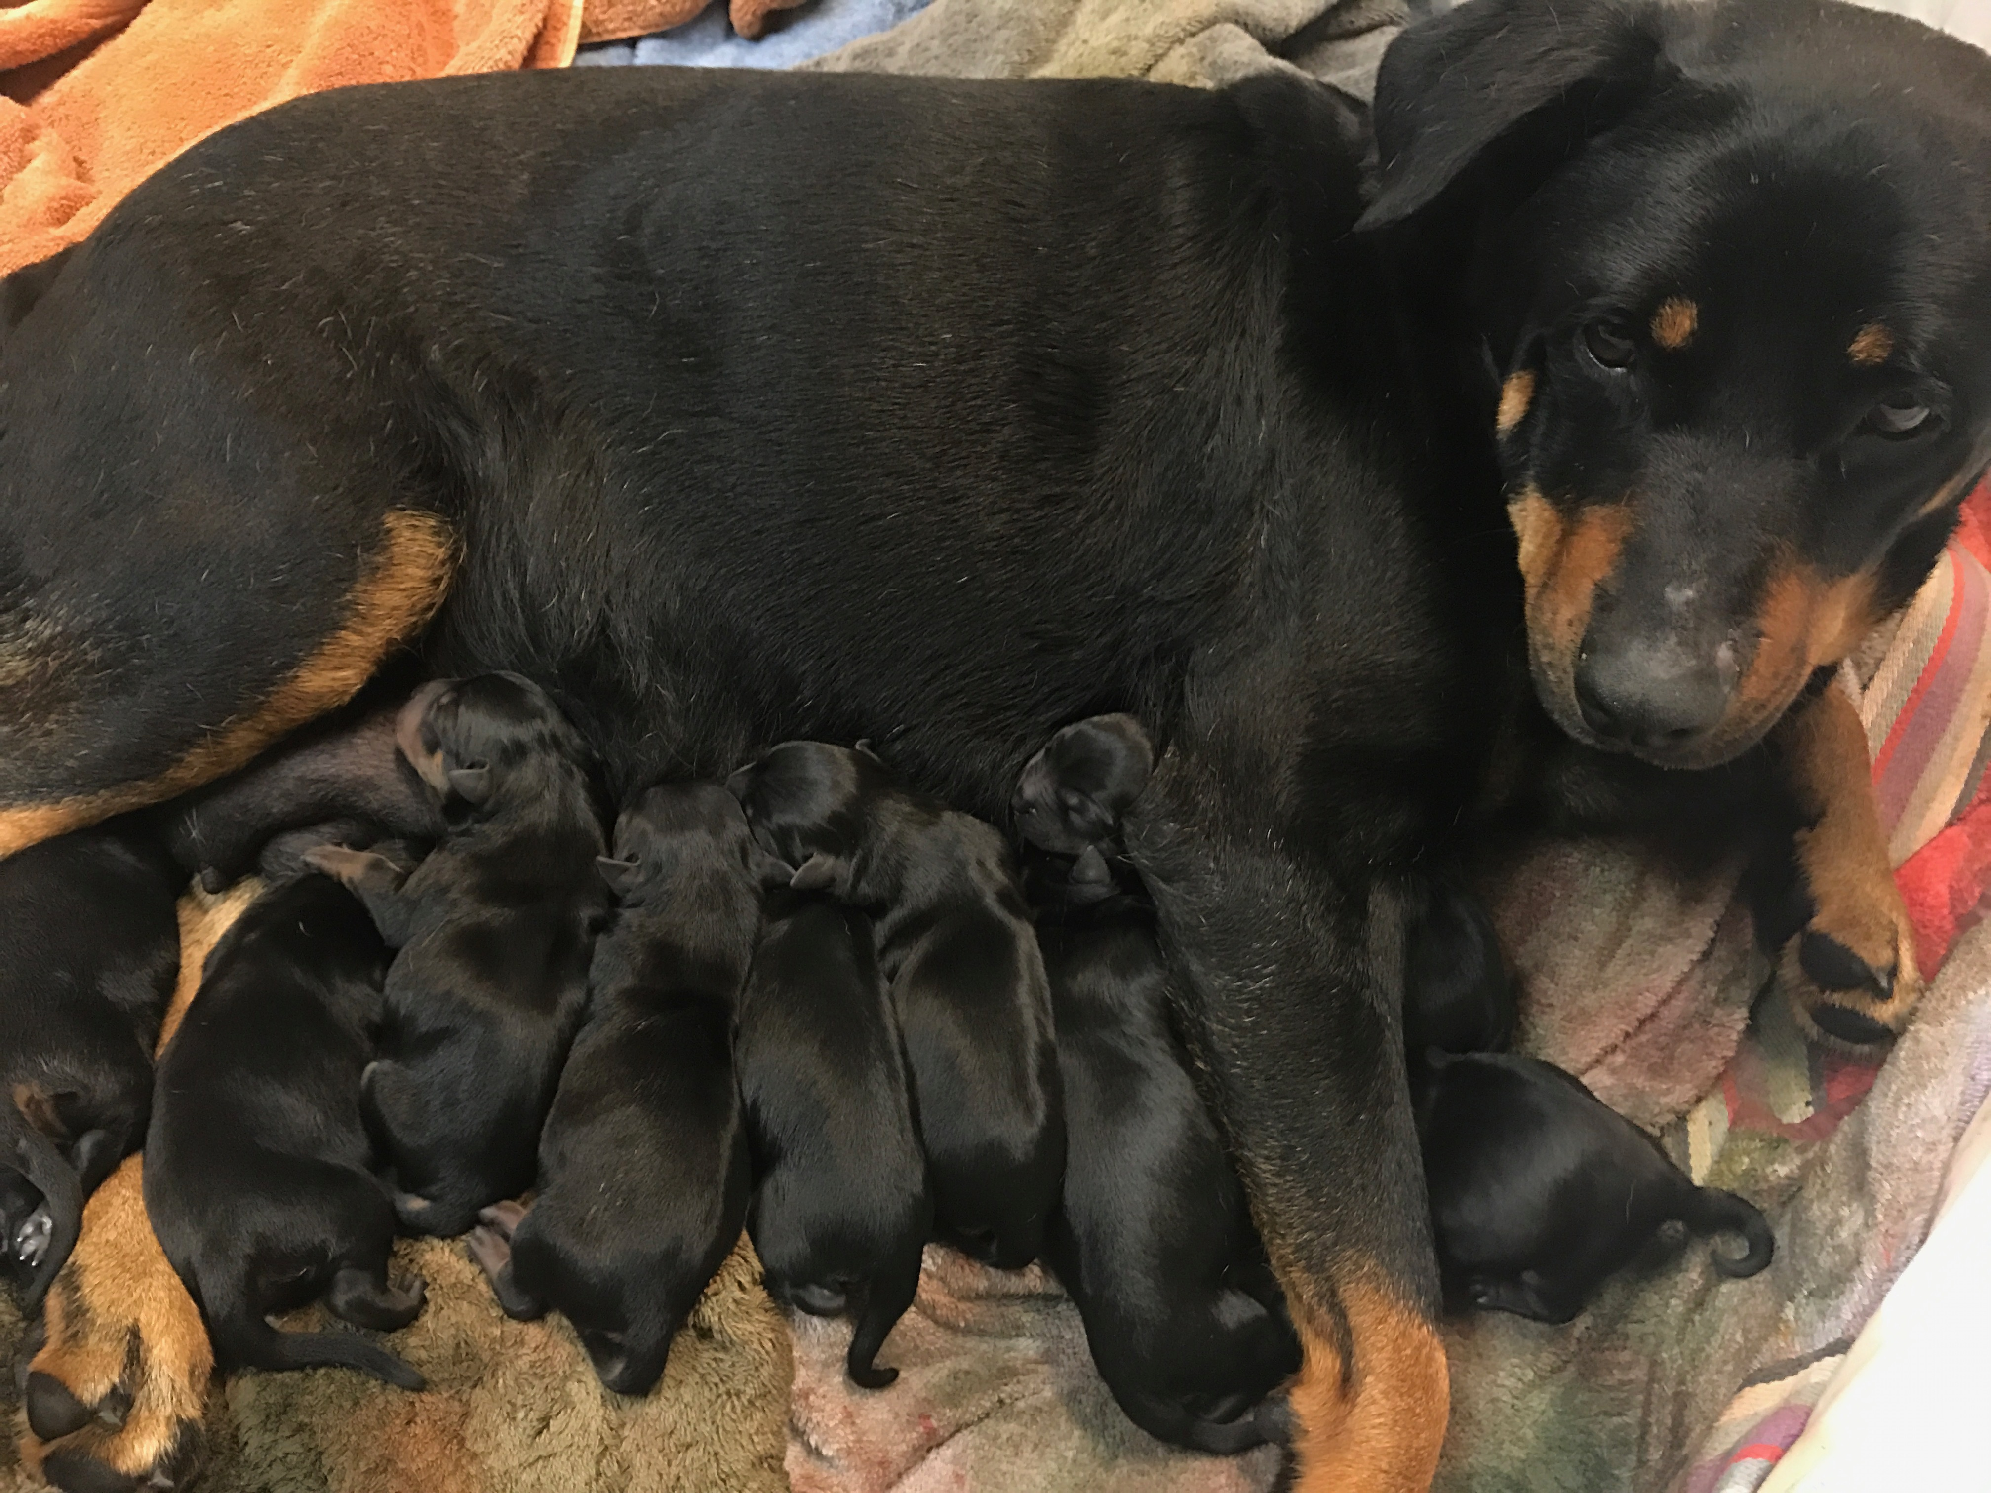
Our Mission and Approach

Slide 3
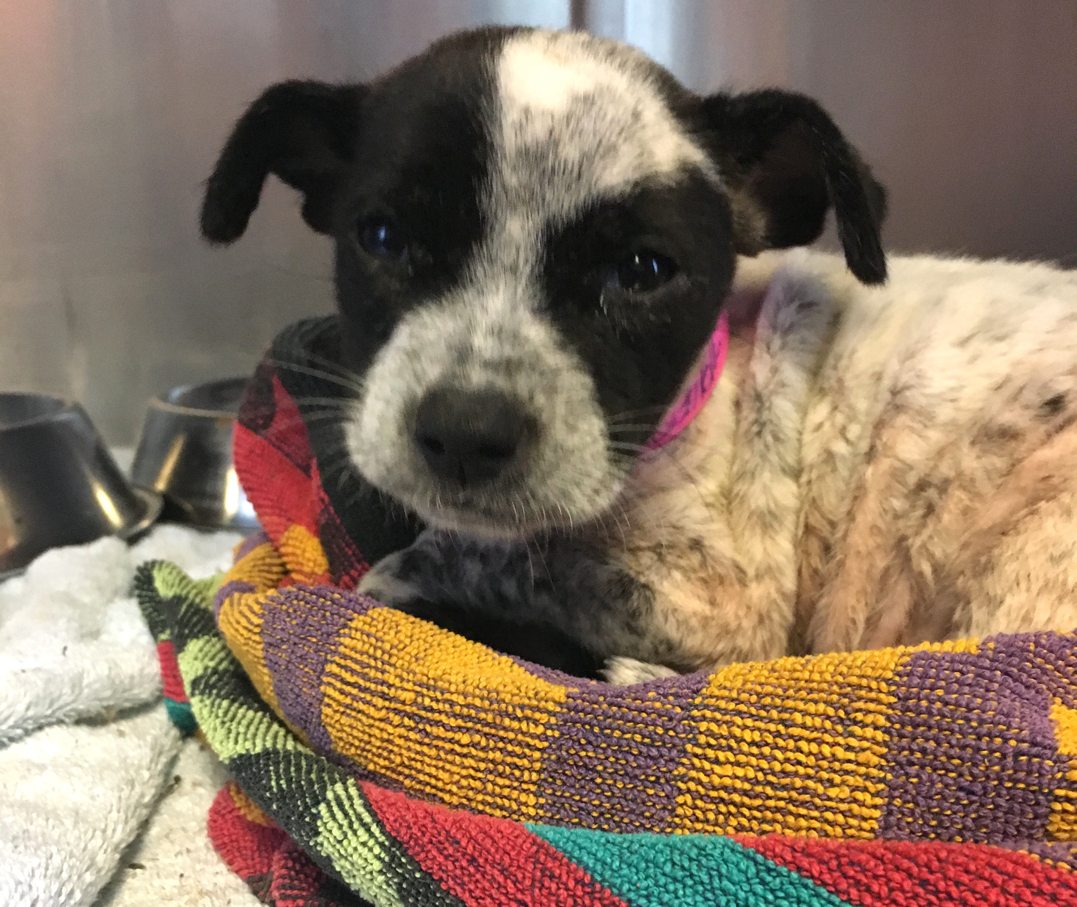
Traditional Thought
Treat just enough to stay alive for stray hold
Euthanize immediately due to “suffering”
Notes:
The traditional thought process at shelters for incoming ill/injured animals is to

Slide 4
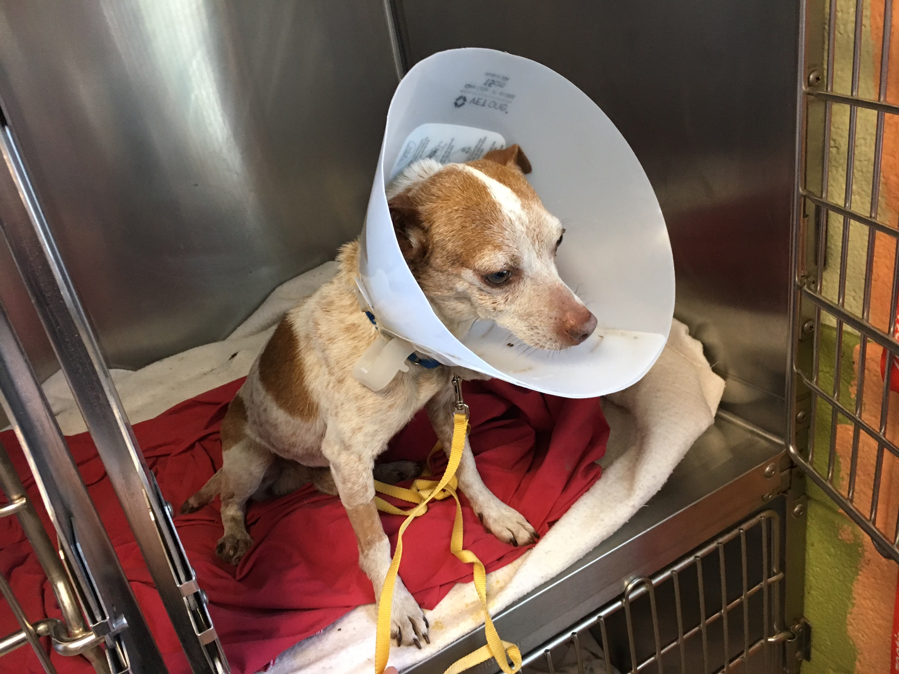
Our Medical Mission
Our priority is to save the life of every treatable homeless dog or cat rather than provide gold standard medical care to fewer animals while others are left behind to die.
Our modus operandi:
We aim for what an animal-lover of average means could reasonably provide.

Slide 5
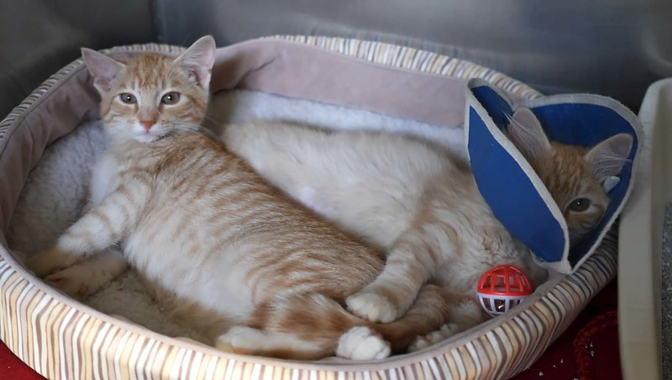
Our Resources Are Not Limitless
If we are to rescue as many cats and dogs at risk for needless euthanasia in other shelters as possible, then we must steward our resources carefully.

Slide 6
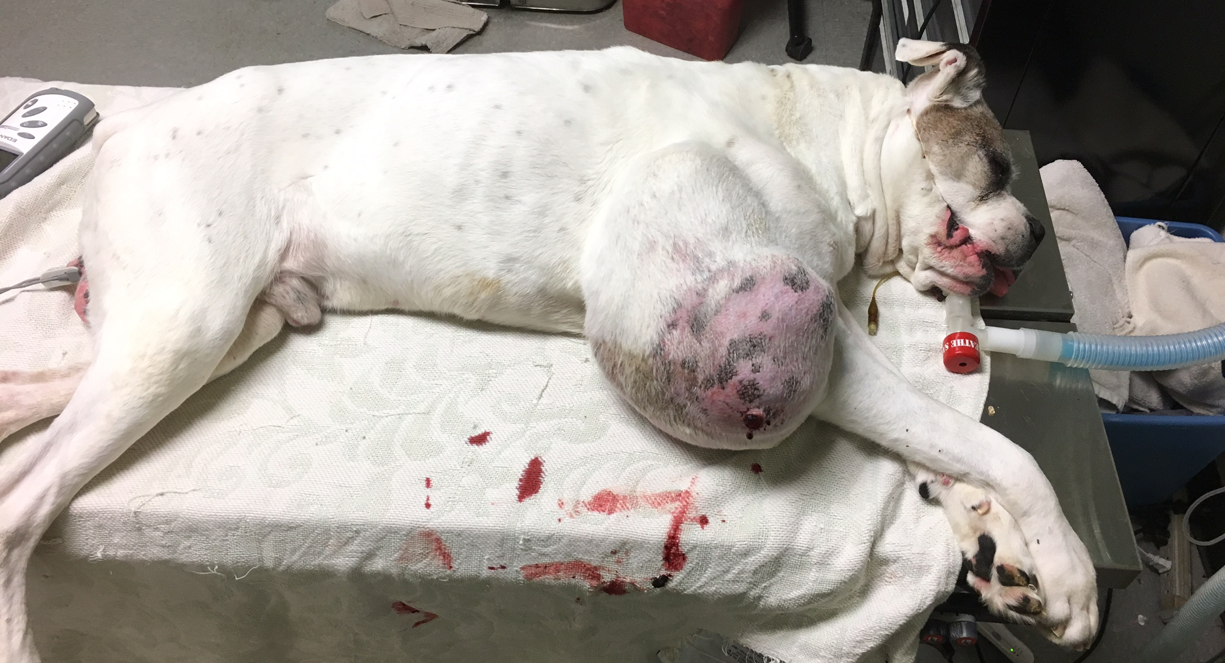
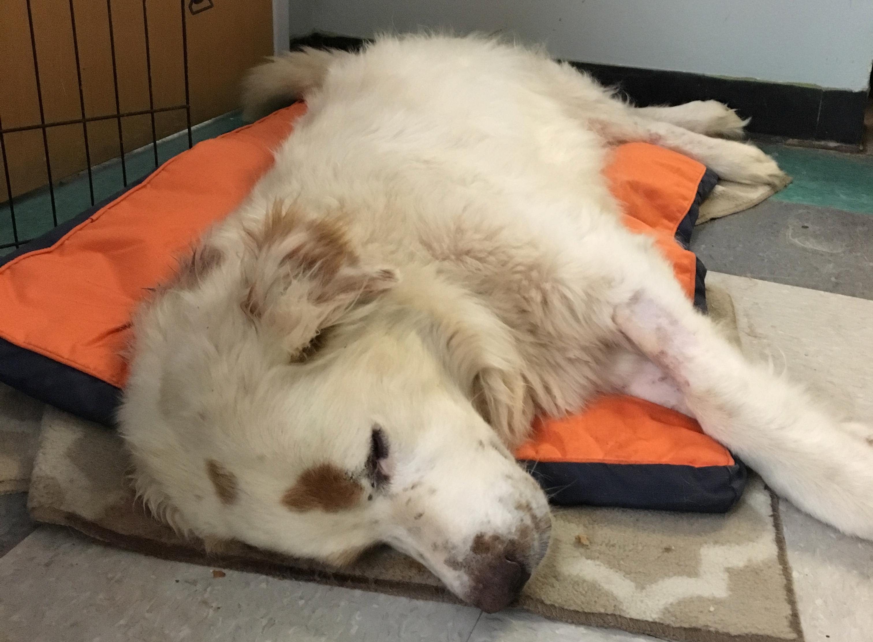
Making Medical Decisions
Treat life-threatening conditions
Alleviate pain
Immediately treat conditions that will get worse if we don’t act quickly
Cure conditions that will lead to long-term pain
As resources allow, we may treat a non life-threatening condition that we have determined is preventing an animal from being adopted

Slide 7
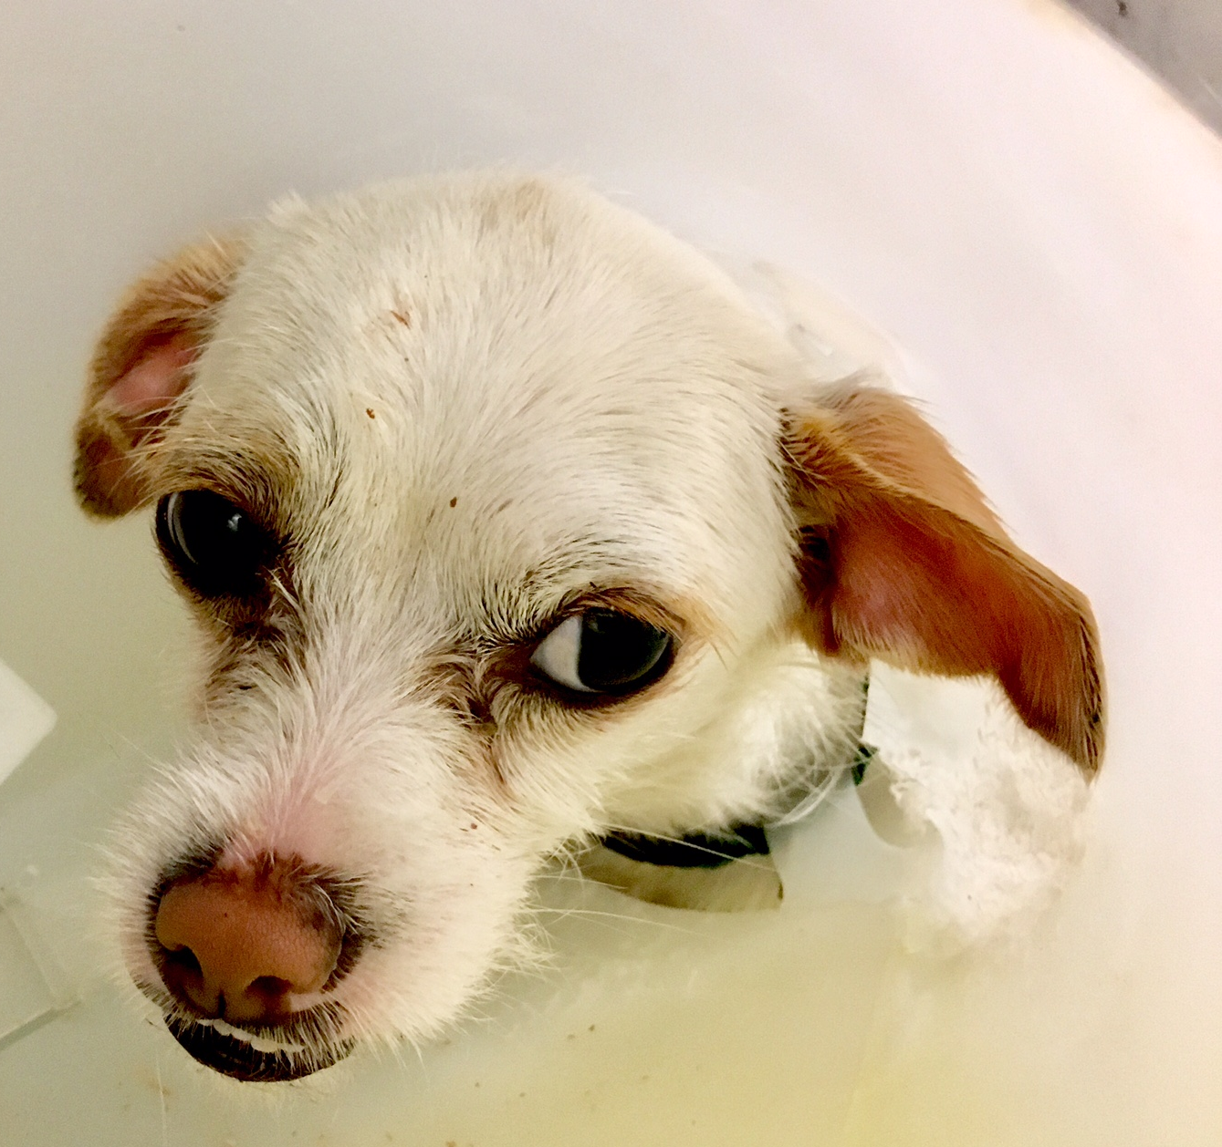
Medical Care at APA!
Goal is to save all salvageable animals, no matter the problem
Treat them as if they will live
Systemizing treatments simplifies process
Get animals out!
Saves space, money and time
Killing is not an option

Slide 8
Euthanasia vs. Kill
Definition of Euthanasia:
The deliberate ending of a life suffering from an incurable, painful, deadly condition for reasons of mercy because without euthanasia, natural death would be preceded by extreme suffering
Definition of Kill:
The deliberate ending of a life NOT suffering from an incurable, painful, deadly condition

Slide 9
Justifiable Euthanasia
Dying from trauma upon arrival or after initial treatment
White gums, shocky
Body will not be functional again even with medical help
Broken spine, severely maimed
Dying from illness upon arrival or after initial treatment
Flat out- white gums, cold
Chronic condition that will result in pet’s death eventually, painful even with help
Bad arthritis, cachexia
Untreatable aggression as diagnosed by a behaviorist

Slide 10
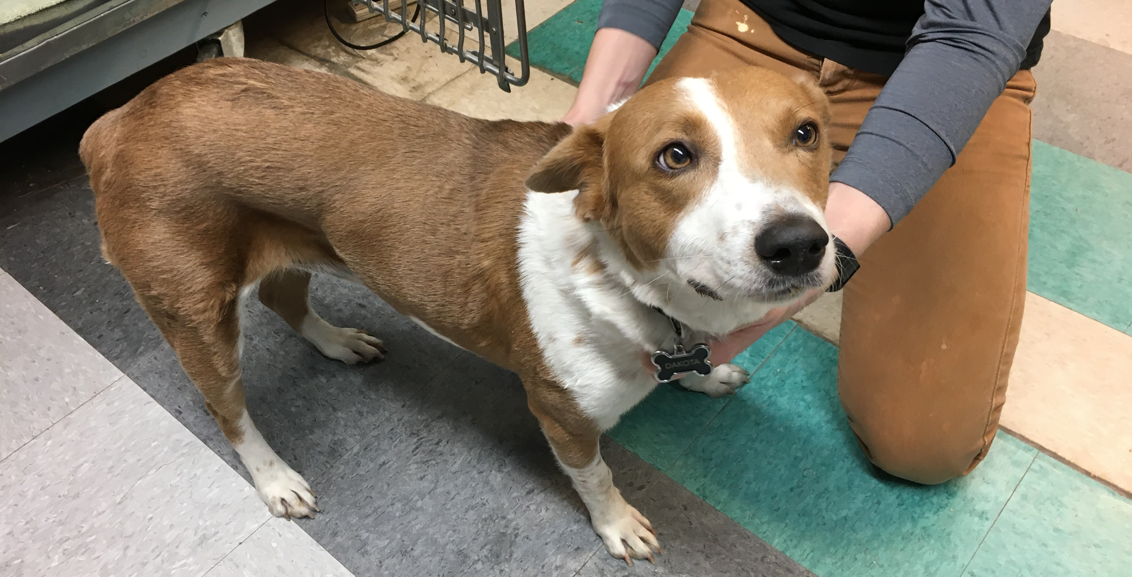
Making it Happen

Slide 11
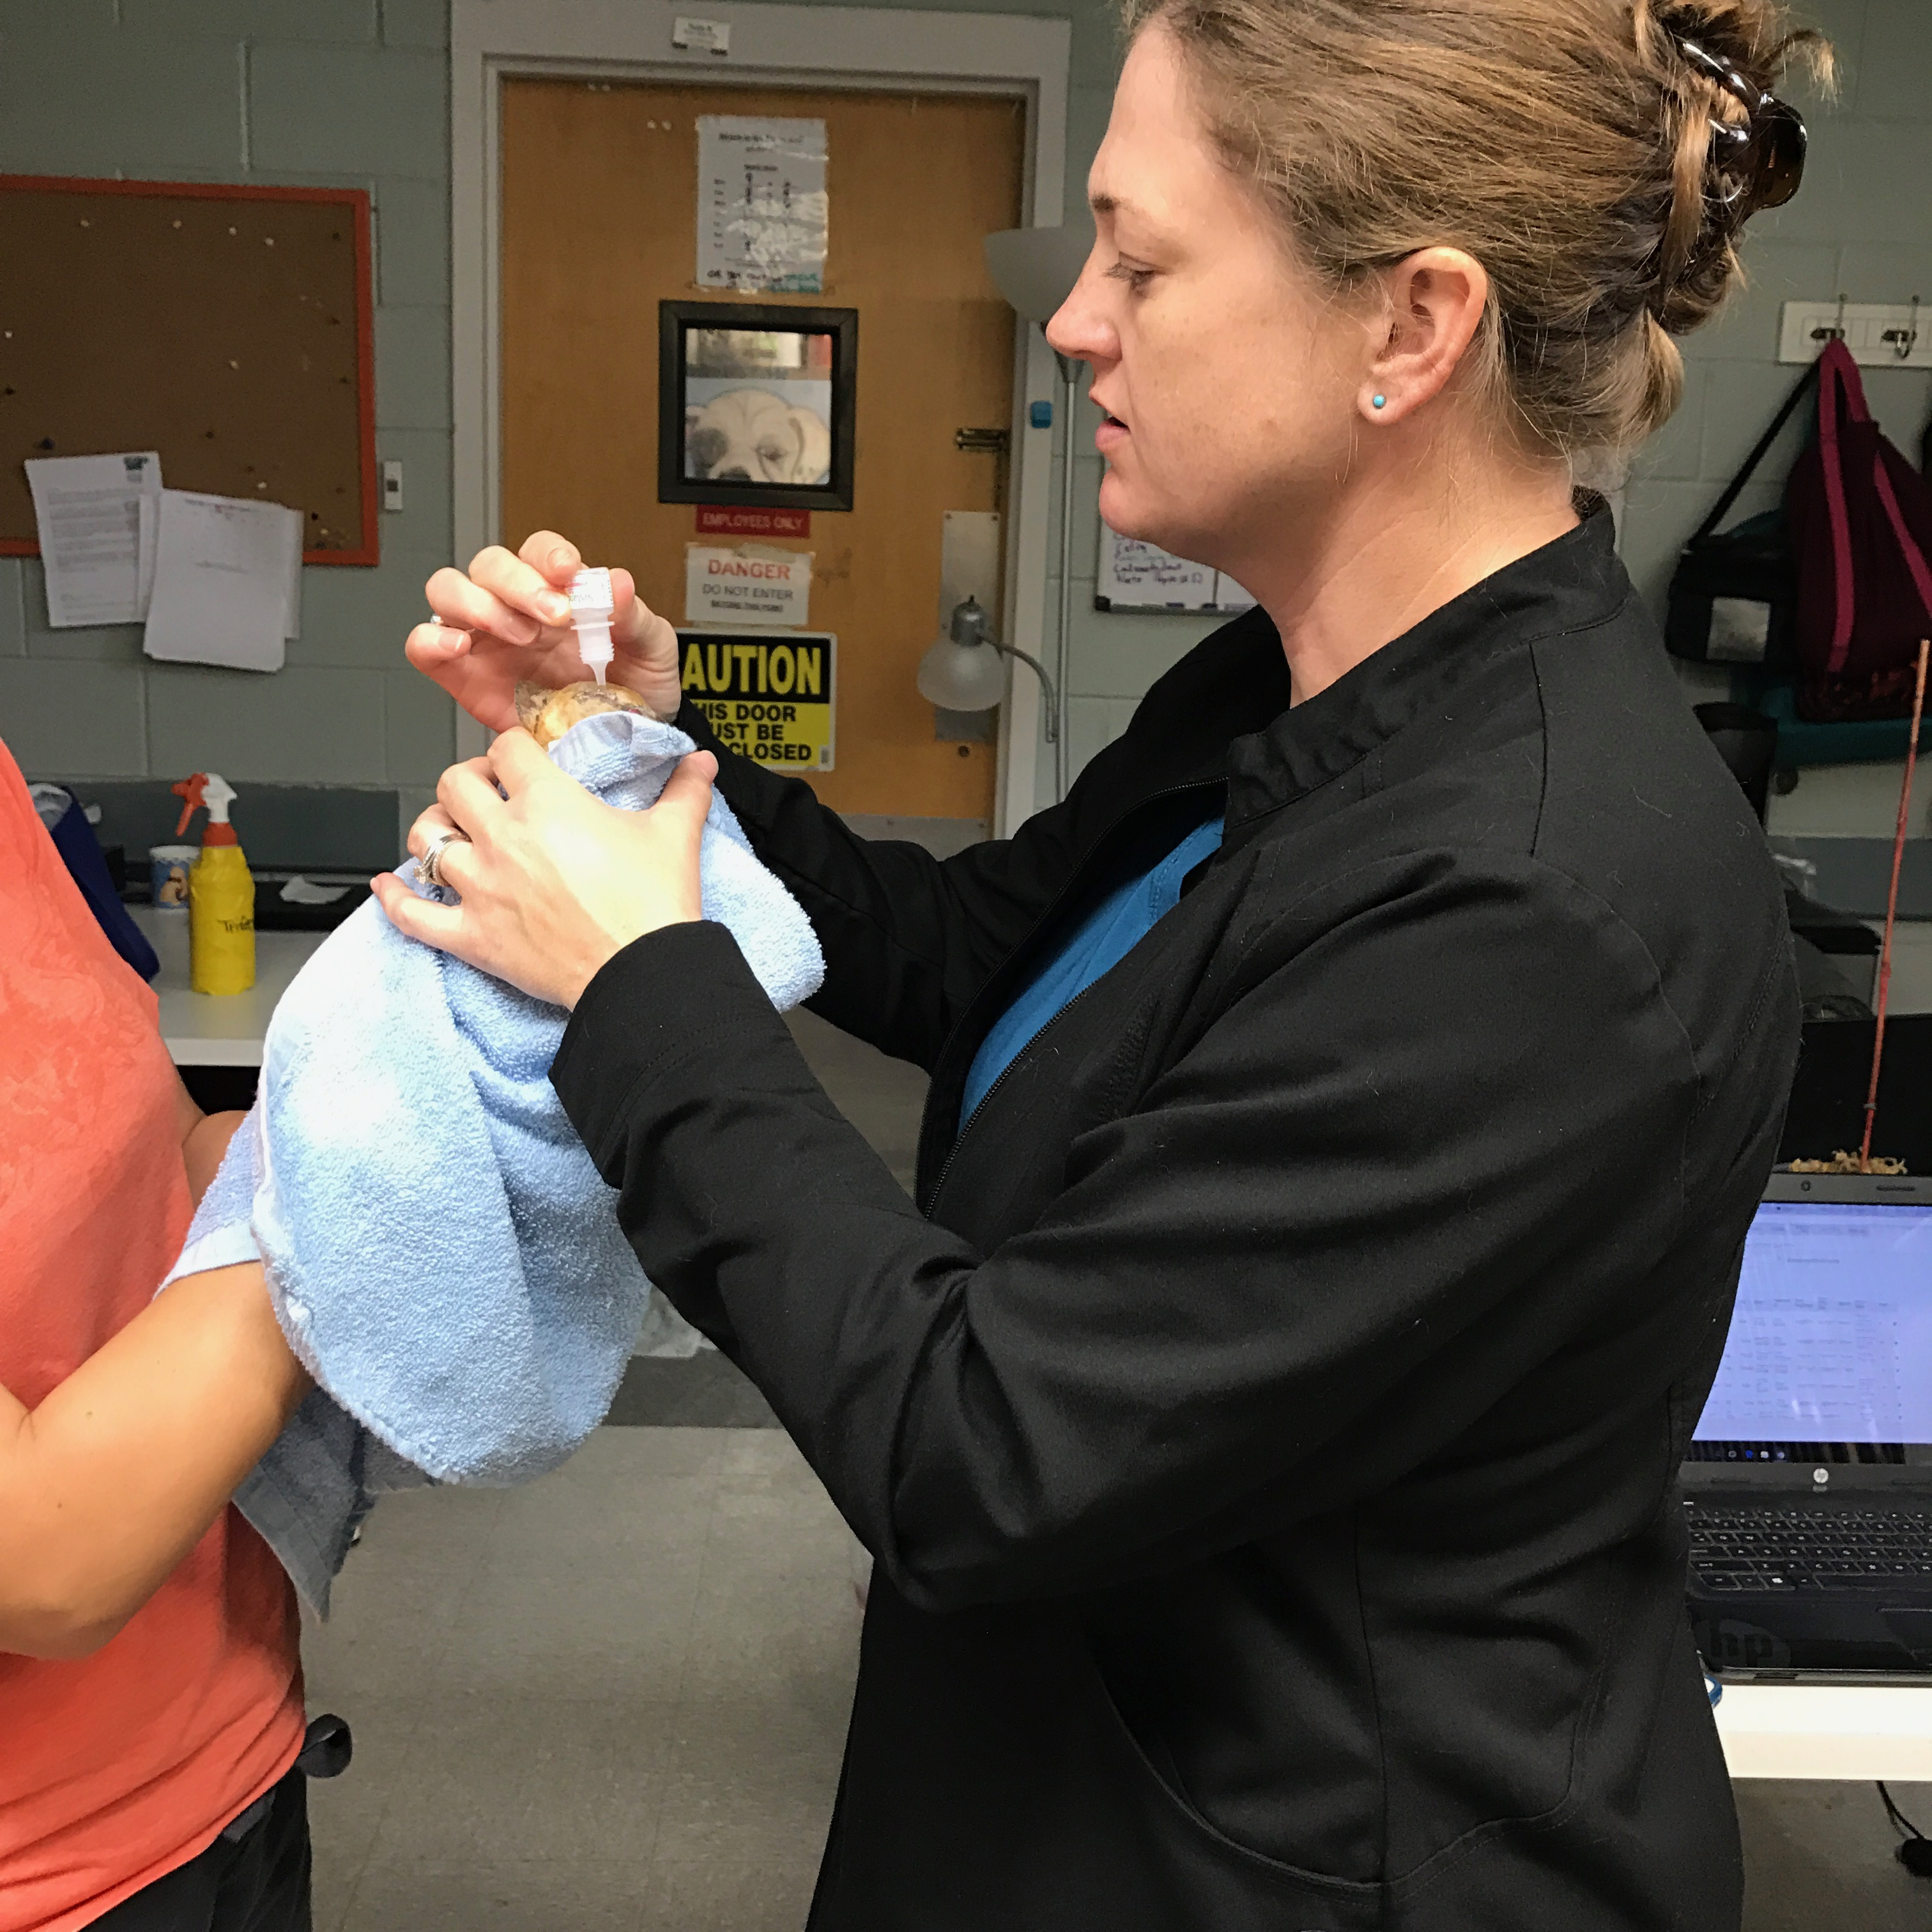
Staffing Overview
Veterinarians
Manager
Technicians
Appointment Tech
Cat Tech
Dog Tech
Hospitalized Tech

Slide 12
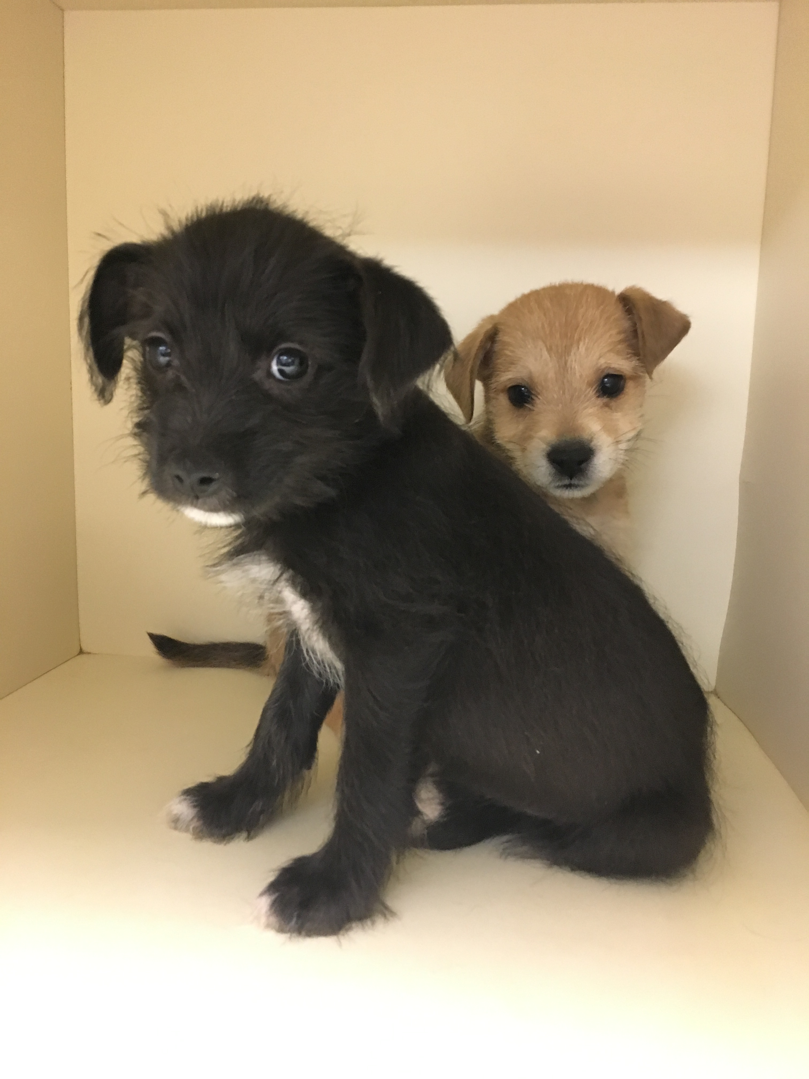
Where We Save Money and Time
Treat what we see
No expensive tests unless really critical to treatment
What happens if the result is negative?
James Herriot Medicine
Nature is your biggest ally
Use what you have
Don’t order expensive drugs unless there is truly no alternative – there almost always is

Slide 13
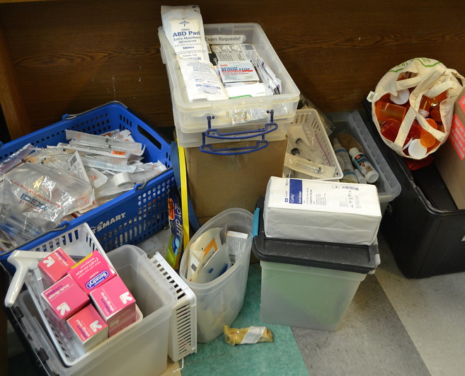
Where We Save Money and Time
Ask for donations and help
Tangible supplies
Chip-ins
Fosters/adopters
Accept ALL donations
Volunteer help
Break up tubes/bottles to share without contamination
Frontline
Eye meds
Find alternatives to expensive medications
Eye meds
Antibiotics
Foster Homes

Slide 14
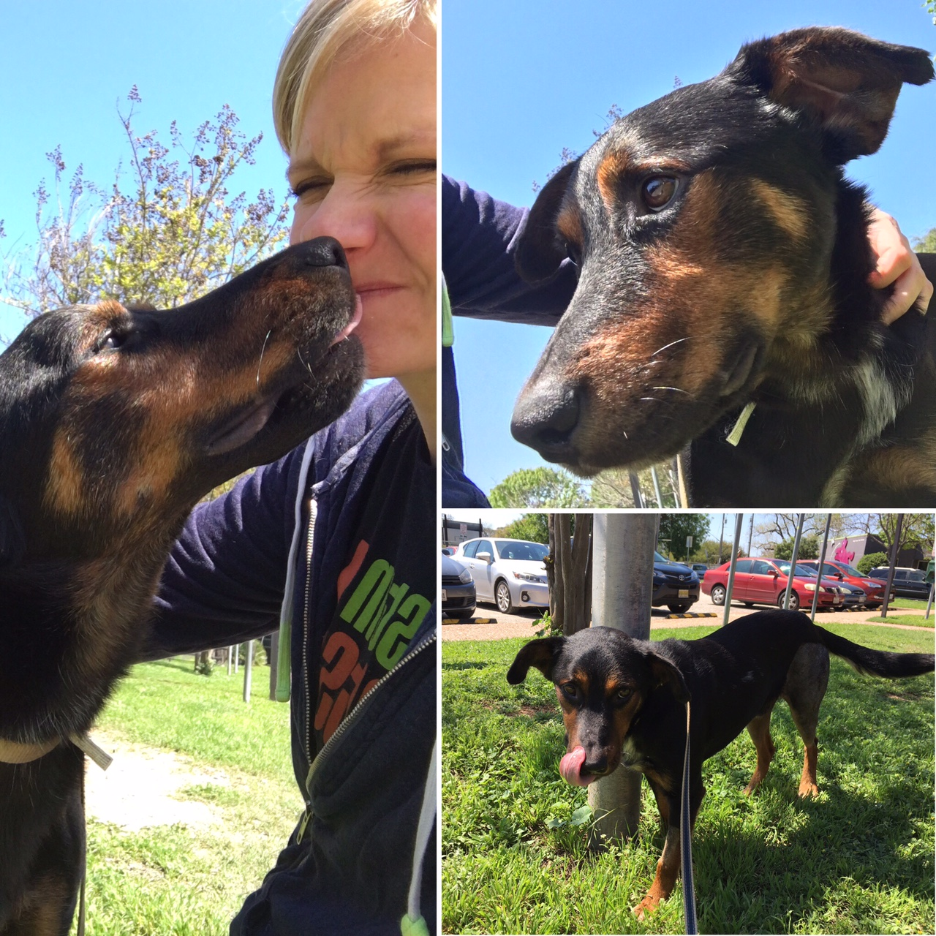
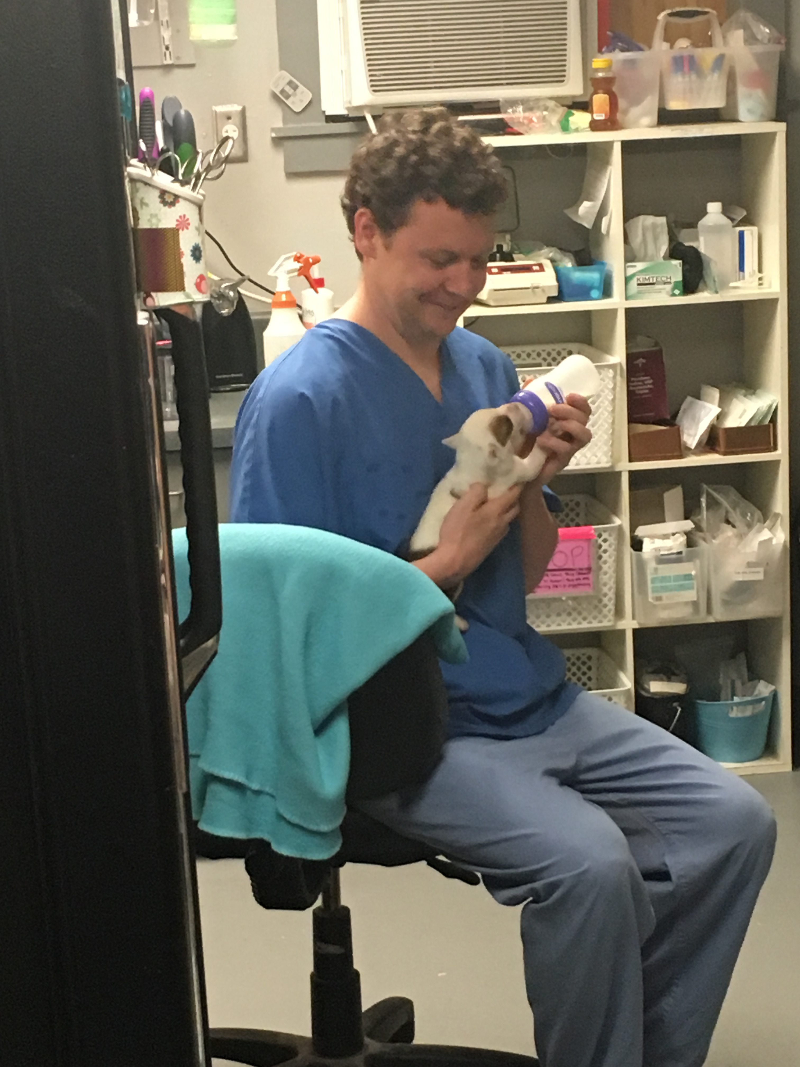
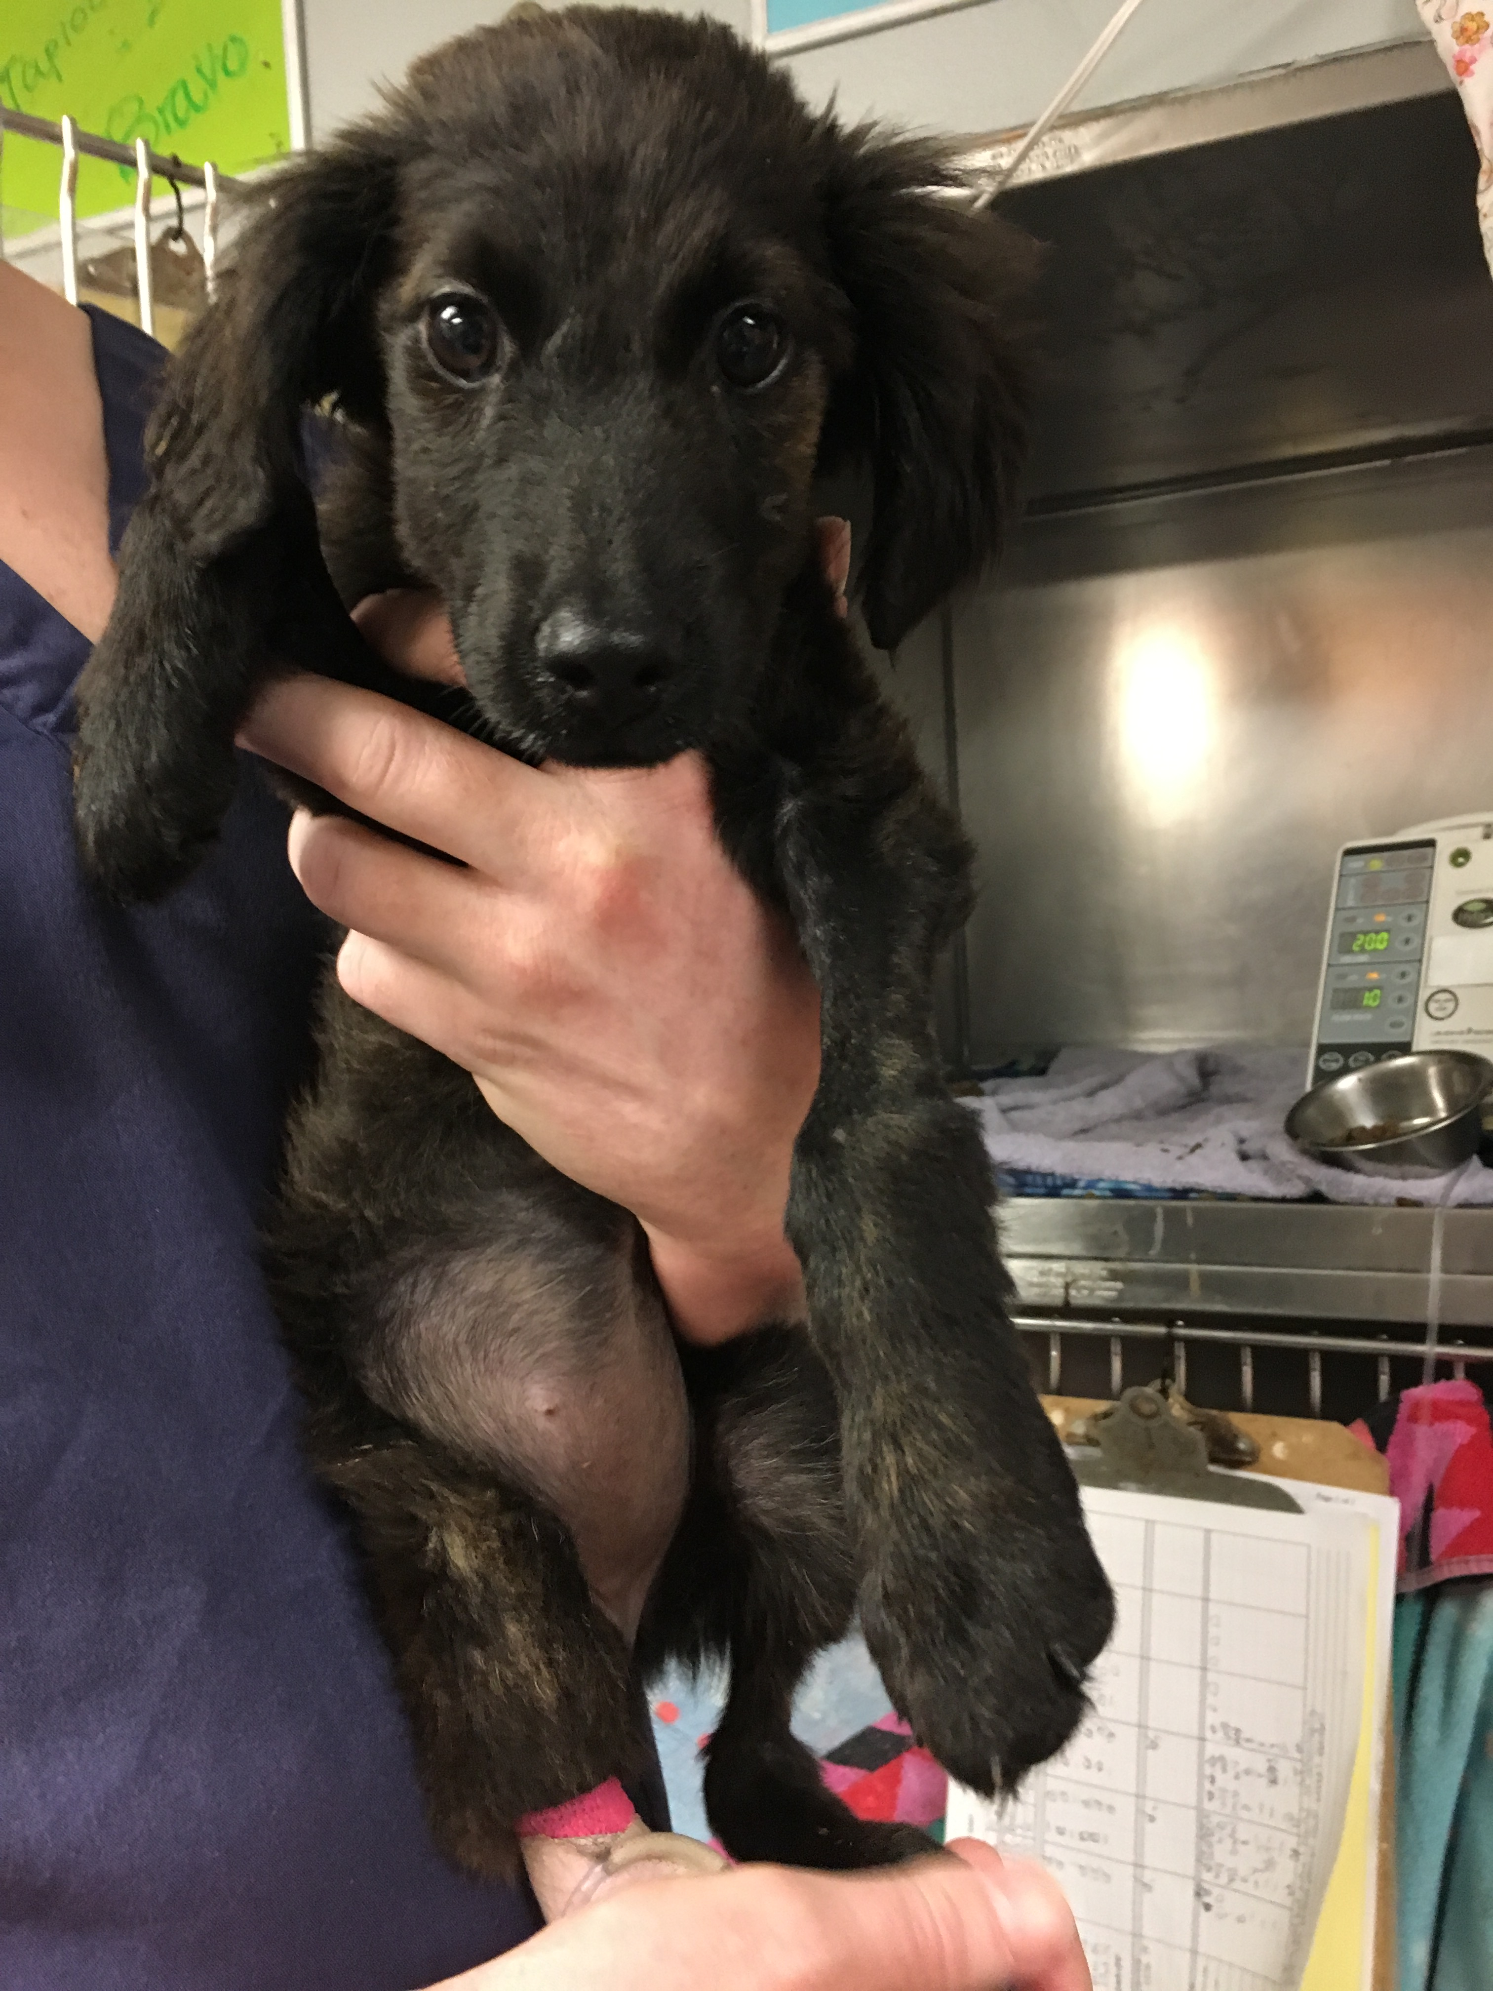
What We See and Treat
Our markers:
QOL
Long term outcome
Notes:
Meaning we will euthanize for poor QOL with no hope for rehab

Slide 15
What We See and Treat
Parvo
Calici
Panleuk
Ringworm
Heartworm
FeLV
Neonatal kittens
Distemper
Neurological (acute and chronic)
Trauma
Chronic conditions:
Hypothyroidism
Hyperthyroidism
Megaesophagus
Diabetes
Seizures
Incontinence
Renal failure
Heart failure

Slide 16
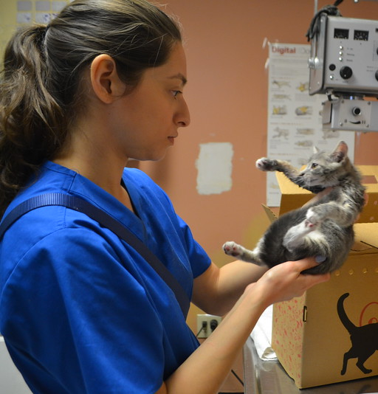
Maddie’s Clinic Apprenticeship for Vet Techs
How to use and follow protocols
How following protocols allows you to treat more animals on a daily basis
What to elevate to a vet
What you can be empowered to do
Time management
Triaging
Working with other teams
Becoming comfortable asking for a second opinion

Slide 17
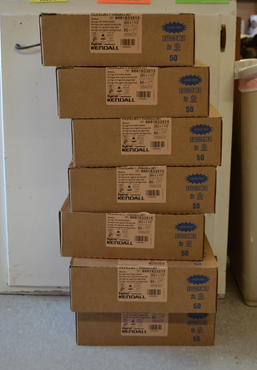
Maddie’s Clinic Apprenticeship for Clinic Managers
Ordering and purchasing
How to maximize donations
Triaging
Managing medical cases
Working with community vets
When to step in and help on the floor and when not to
Utilizing volunteers (wellness clinic)
Continuing education for staff
High volume s/n
Crowd funding
Creating protocols that are effective and easy to use
Identifying protocols that aren’t effective or aren’t working

Slide 18
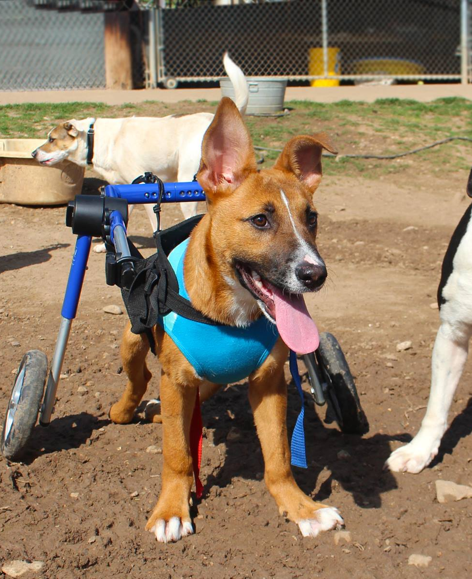
Maddie’s Clinic Apprenticeship for Veterinarians
How to manage chronic medical cases
Diagnosing without testing (expensive testing)
Using physical exams and clinical symptoms to start a treatment plan
Time management
Empowering technicians
Working with other teams
Taking staff, volunteer and foster perspectives into consideration in euthanasia cases

Slide 19
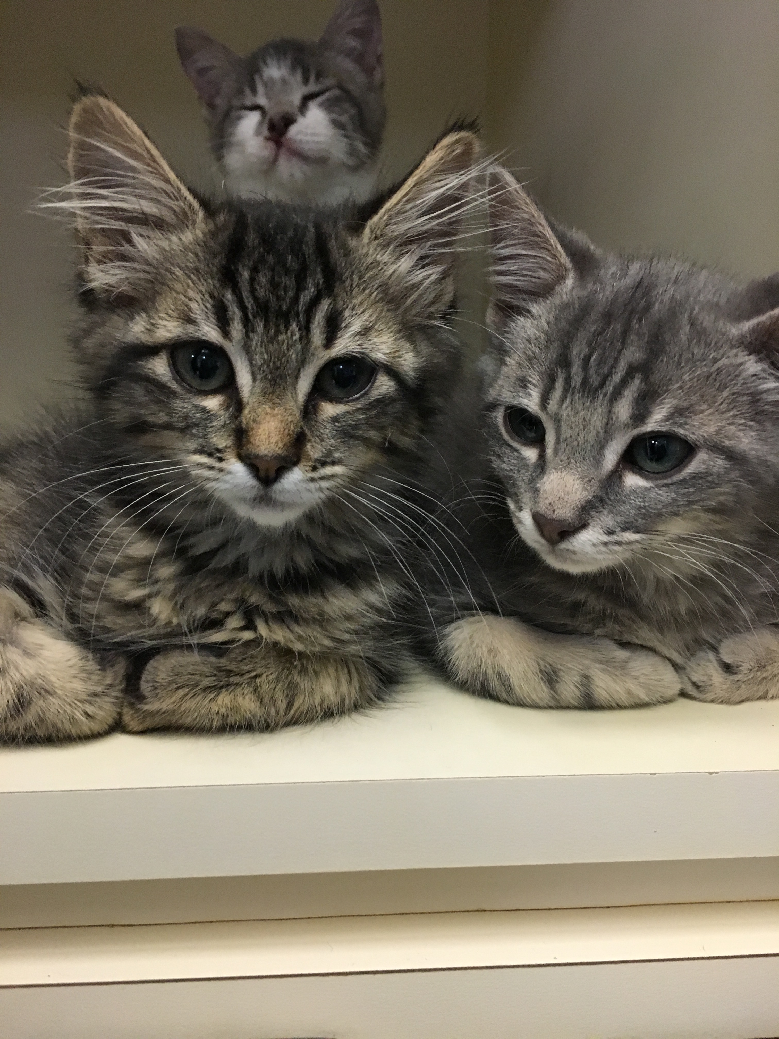
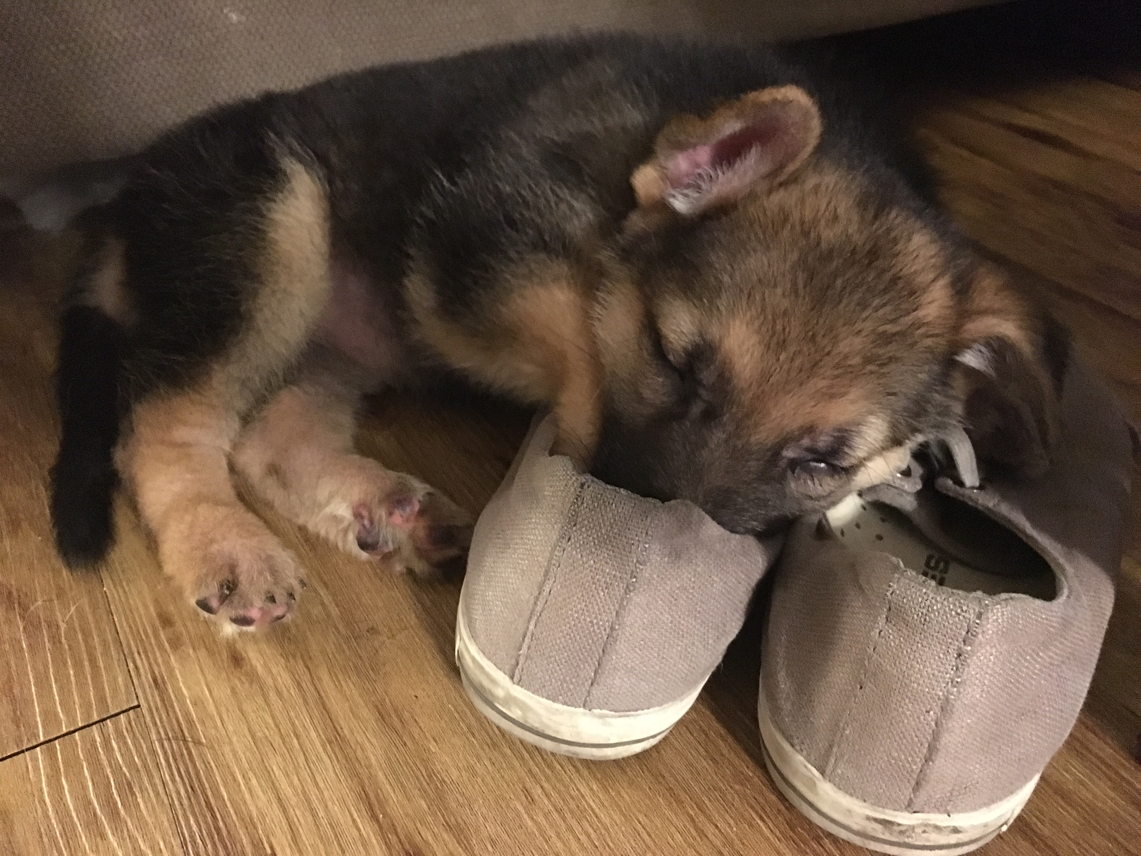
For more information about the the APA! Medical Clinic please visit:
austinpetsalive.org/about/programs/medical-program/
Copyright © 2016 Austin Pets Alive! All Rights Reserved

